Slide 1
Machine Learning Pipeline on Snowflake
End-to-end ML lifecycle: Feature Engineering, Training, Deployment, and Monitoring

Slide 2
Agenda
Business Problem
Architecture
Feature Store
ML Workspace & Notebooks
Experiment Tracking
Model Registry
Model Monitoring
Image Repository
Snowpark Container Services (SPCS)
Job Execution
Automation with Tasks
Evaluation Metrics
Next steps
Summary

Slide 3
Business Problem
Traditional ML workflows are fragmented:
Data stored in one system
Training done in external environments
Deployment requires additional tools
Manual version tracking
Difficult to monitor model performance
Snowflake unifies data, ML, and operations in a single platform.

Slide 4
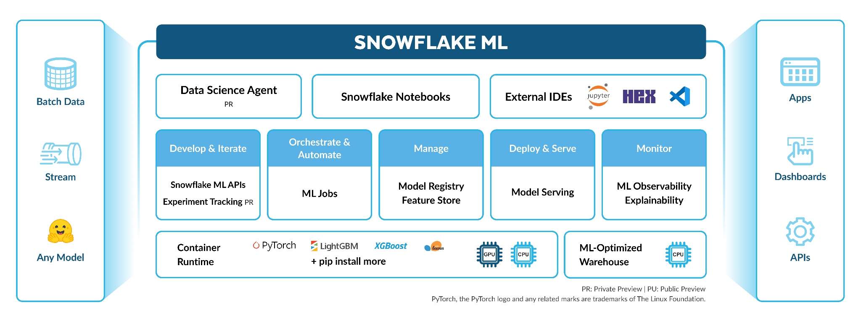
Snowflake ML Architecture

Slide 5
Feature Store
Centralized repository for ML features.
Benefits:
Consistent features for training and inference
Eliminates duplicate feature logic
Ensures point-in-time correctness
Reusable feature definitions across models
Improved governance and lineage tracking
Implemented:
Feature Store with 11 feature views

Slide 6
ML Workspace & Notebooks
Integrated development environment inside Snowflake.
Capabilities:
Python file and SQL, and Notebook in the browser
Direct data access without movement
Built-in compute environment
Visualization and debugging tools
Removes dependency on local or external environments.

Slide 7
Experiment Tracking
Systematically records:
Model versions
Training parameters
Performance metrics
Training artifacts and logs
Implemented:
Experiment logging enabled
Enables comparison of experiments and reproducible results.

Slide 8
Model Registry
Centralized storage for trained models.
Provides:
Version control
Promotion workflow (staging → production)
Metadata and documentation
Rollback capability
Implemented:
Model registry to register model with metadata
Ensures only approved and tracked models are deployed.

Slide 9
Model Monitoring
Tracks model performance after deployment.
Monitors:
Prediction drift
Data drift
Accuracy changes over time
Feature-level distribution shifts
Implemented:
Model monitor to monitor model and detect drift
Supports proactive retraining and governance.

Slide 10
Image Repository
Stores Docker images securely inside Snowflake.
Advantages:
Consistent runtime environments
No external container registry needed
Governance and access control included
Easy deployment to SPCS
Implemented:
Image stored in snowflake image repository
Ideal for custom ML frameworks and dependencies.

Slide 11
Snowpark Container Services (SPCS)
Runs Docker containers directly in Snowflake compute.
Use cases:
Custom ML training
Batch inference
Microservices / APIs
Large-scale data processing
Implemented:
Training and inference workloads deployed in SPCS
Snowflake manages scaling, security, and orchestration.

Slide 12
Executing Jobs in SPCS
Jobs run one-off tasks such as:
Training scripts
Batch inference workloads
Data transformations
Snowflake handles:
Logging
Scaling
Failover and retries
Implemented:
Inference and training jobs

Slide 13
Automation Using Tasks
Tasks schedule and automate ML processes.
Example workflow:
Train model daily
Generate monitoring reports
Run batch predictions
Update ground truth data
Implemented:
Automated job execution on schedule
Eliminates external schedulers.

Slide 14
Evaluation Metrics Overview
MAE (Mean Absolute Error):
Measures the average difference between predicted and actual values.
Our MAE = 1.59 days (On average, predictions are off by about 1.6 days.)
RMSE (Root Mean Squared Error):
Penalizes larger mistakes more heavily.
Our RMSE = 1.97 days (Typical prediction error is around 2 days, with big errors being rare.)
Interpretation:
The model performs well for a 7-day forecasting window.
Lower values = better prediction accuracy.

Slide 15
Next Steps
Refactor experimental code into clean, production-ready modules
Continue improving features and model performance
Guide customer on CI/CD best practices in snowflake
Next presentation will focus on the model details:
Feature importance
Error analysis
Interpretability insight
Optimization strategy

Slide 16
Summary
Snowflake provides a complete ML ecosystem:
Unified data and compute
Governed feature store
Notebook-based development
Automated experiment tracking
Model registry and versioning
Monitoring for drift detection
Container execution (SPCS)
Automated pipelines via Tasks
Enables reliable, scalable end-to-end ML workflows.

Slide 17
Thank you.
Questions

